Slide 1

Sync+ 2.0
Phase4_U554_R09 –Baidu
Baidu
Updated on 2022-04-24
Desired Outcome
Awareness
Decision
Escalation Help
Think
Point of view
Plan to Implement
Implement

Slide 2
{U554_R09} Software overall status {yellow}
Software key info
Refer SWAD for the details:
MCU version: 20220326_417_PRO
SoC User version: 20220326_0657_DL13_R09.PRO_User
Verification scope and method:
{Full verification} executed with pass rate 98%, 0 P1 and 15 P2 issues found and not fixed. Refer test report for detail.
Main changes compared with previous version, refer RN for the details, highlights listed below:
Non-compliance issue list, refer attached file for detail, P1 issues listed below:
APIMCIS_xxxxxx
……
Open P1 issue list with risk evaluation – refer slide 3
Open AIMS with risk evaluation – refer slide 4
Memory leak, VR subjects test result – refer slide 5,6,7
Notes:
Add P1 weekly burn down chart

Slide 3
{U554_R09} Open P1（IG） issue list with risk evaluation
遗留1个IG问题，分析影响较小，非block issue。相关问题目前已经在当前版本中解决，后续更新Jira状态后给到测试进行验证关闭。
Key | Created | Summary | Root cause | Status | Fixversion | Priority | risk evaluation
APIMCIS-27949 | 2021/5/7 4:57:00 AM | Phase4:Vehicle query violation failed | 第三方数据更新慢问题，已反馈资源方处理。无需重新发版。 | 待办 | 无需发版，第三方数据解决 | Immediate Gating | 风险评估：L 与第三方确认，当前交管局相关的最新信息未给到第三方进行接入，对于江苏地区的数据通常有3-6个月左右的延迟。 与福特沟通是否需要采用其他方式对客户进行提示。
Notes:
Add P1 weekly burn down chart

Slide 4
{U554_R09} Open AIMS with risk evaluation
目前Jira上未遗留工厂问题。
Notes:
Add P1 weekly burn down chart

Slide 5
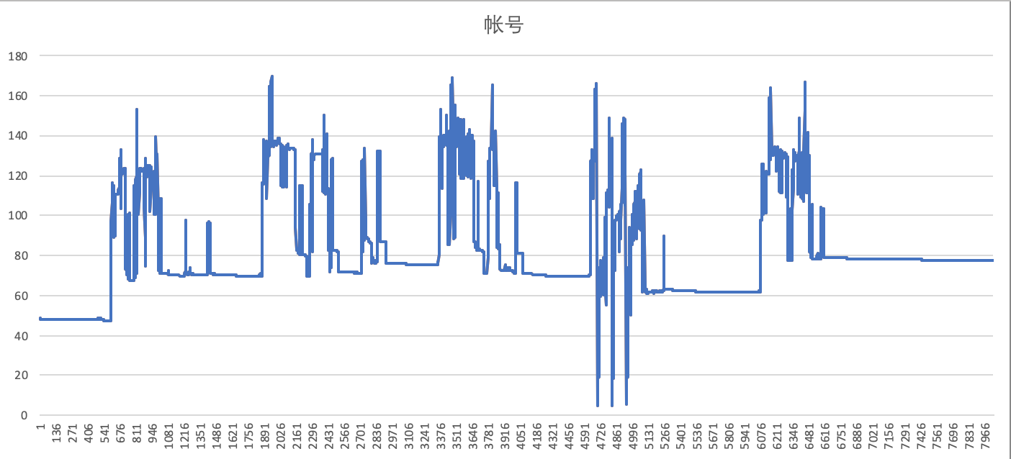
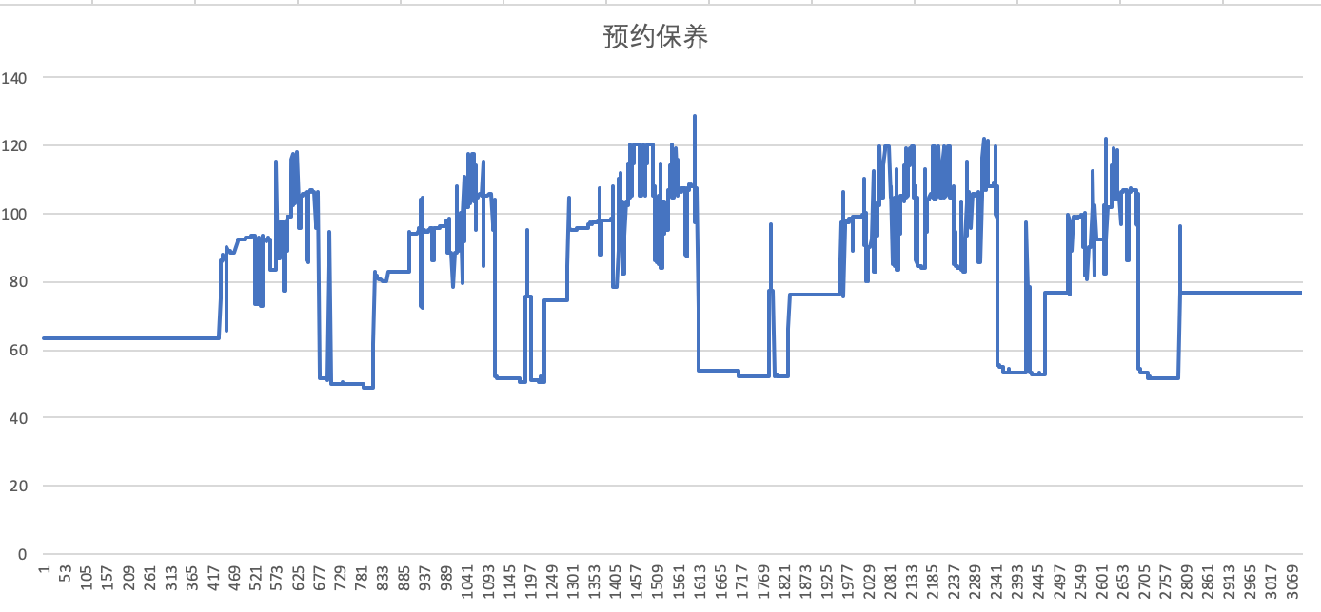
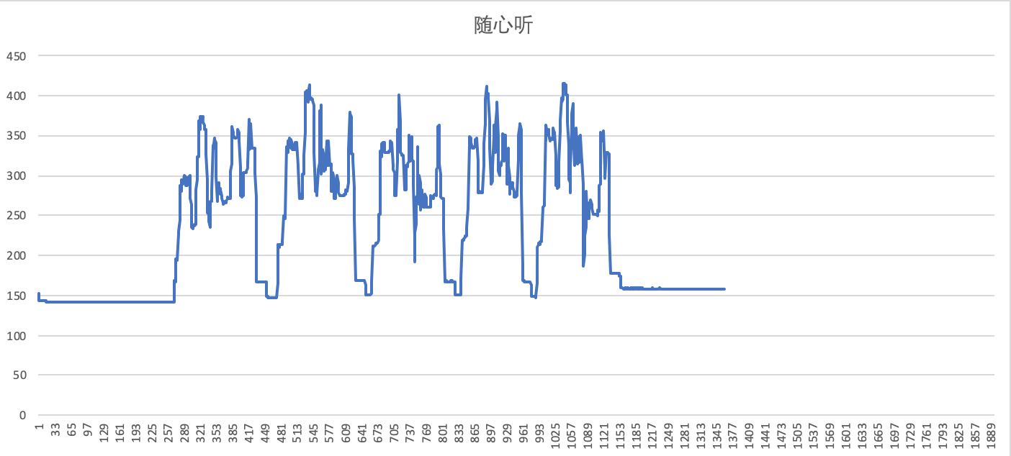
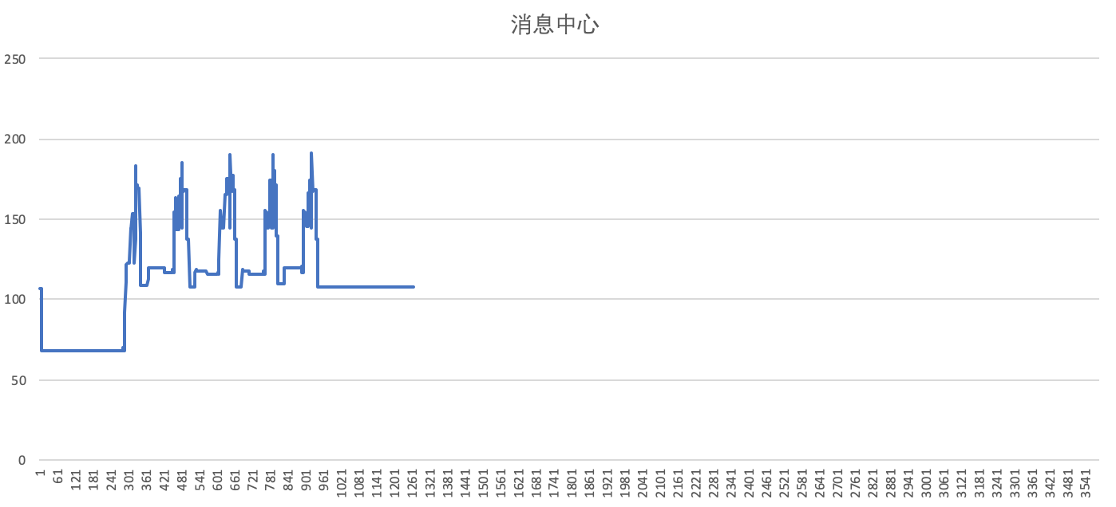
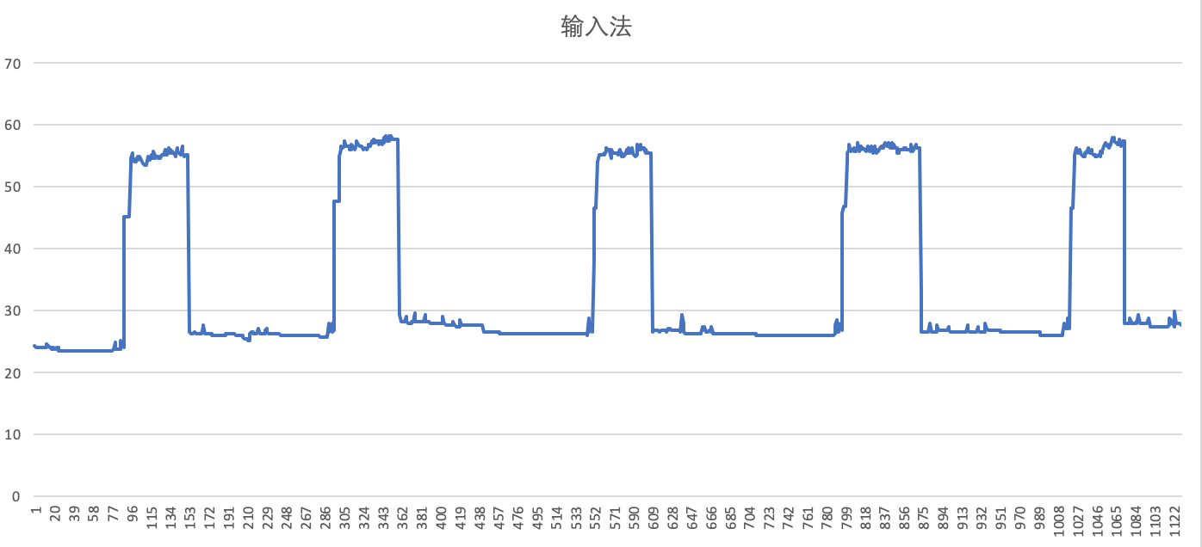
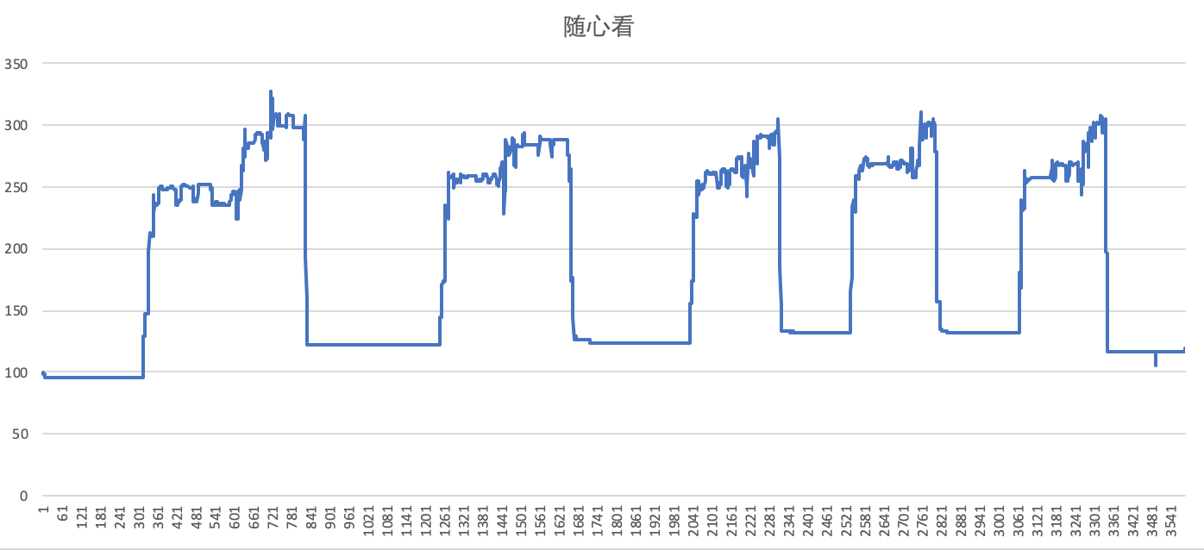
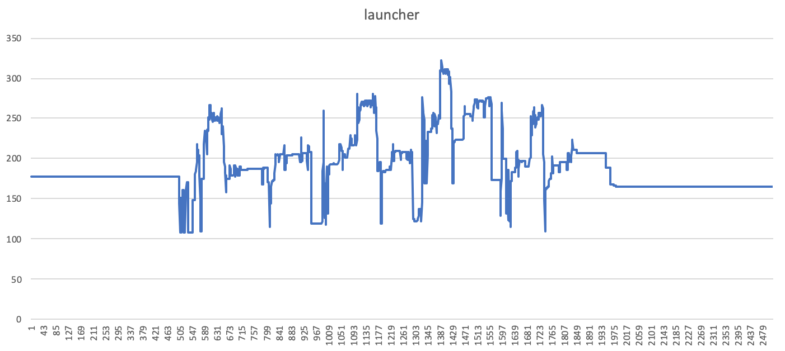
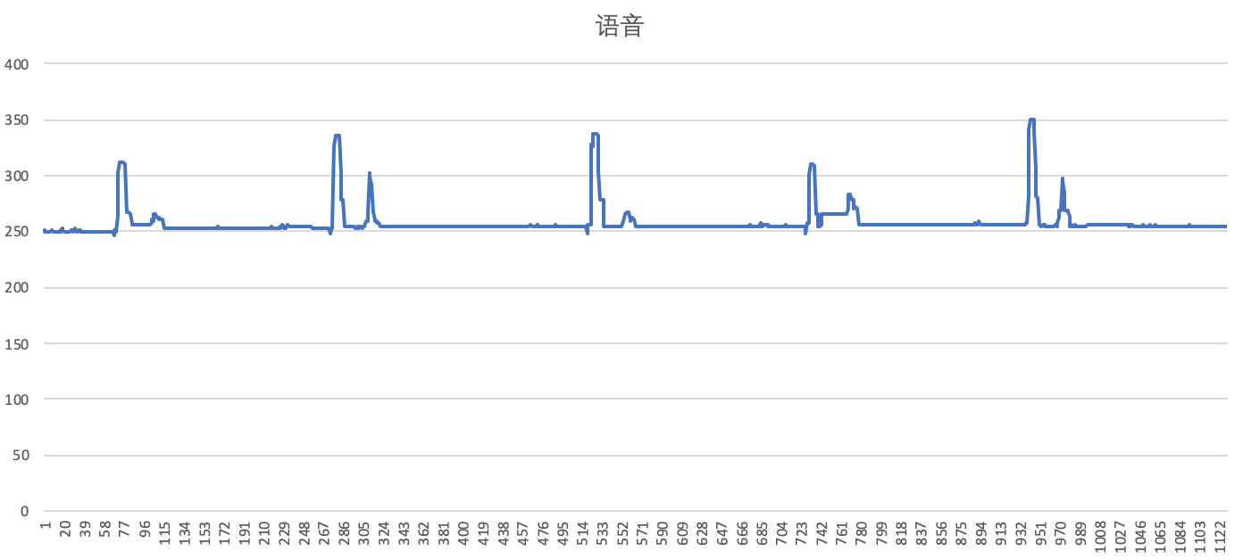
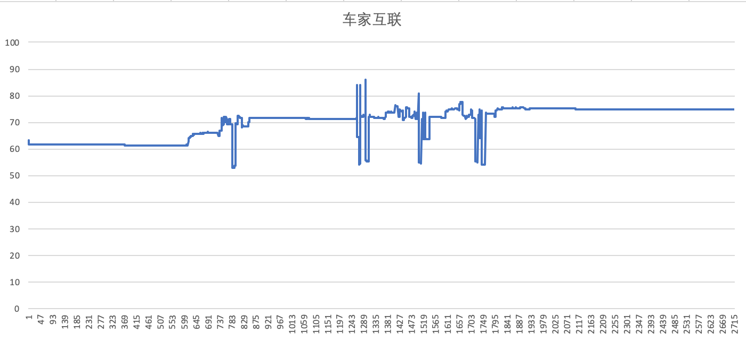
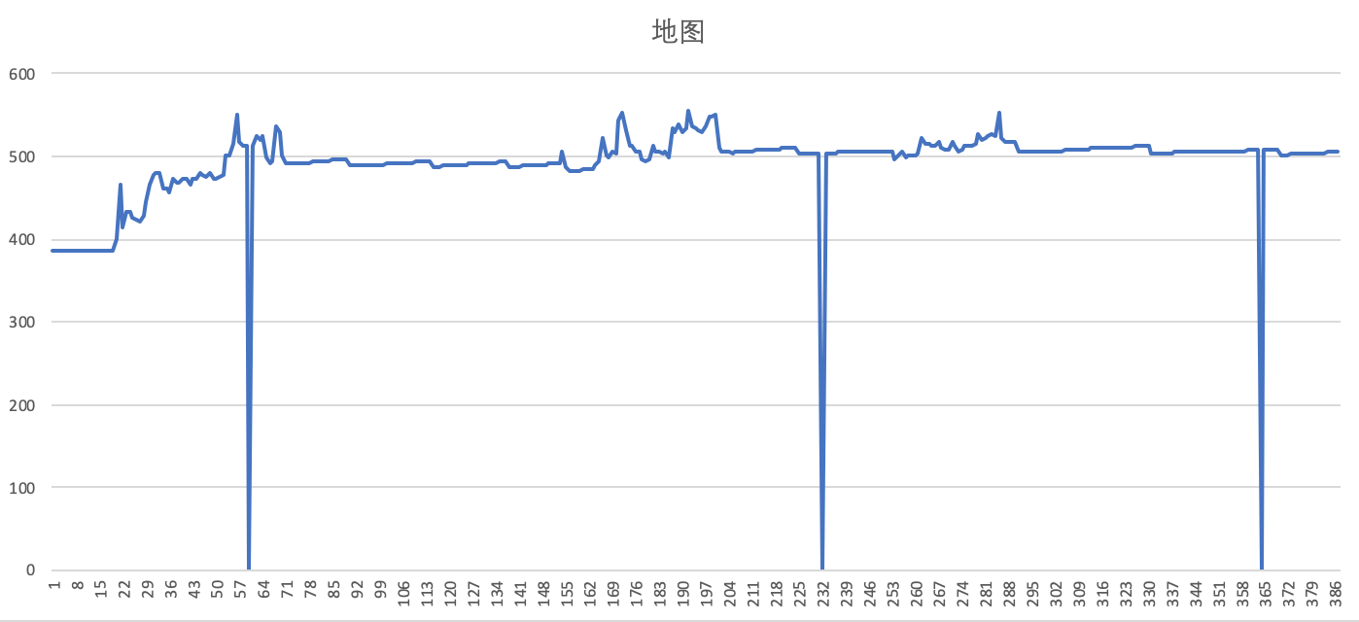
{U554 R09} 内存泄漏专项测试

Slide 6
{U554 R09} 语音专项测试
唤醒词唤醒率：Pass
场景化命令词识别率
AI能力 | 指标项 | 通过标准 | 实测结果 | 测试结论
暂停播放 | 低噪 | 85% | 100% | PASS
 | 中噪 | 85% | 100% | PASS
 | 高噪 | 80% | 100% | PASS
继续播放 | 低噪 | 85% | 99% | PASS
 | 中噪 | 85% | 100% | PASS
 | 高噪 | 80% | 99% | PASS
上一首 | 低噪 | 85% | 100% | PASS
 | 中噪 | 85% | 85% | PASS
 | 高噪 | 80% | 95% | PASS
上一曲 | 低噪 | 85% | 98% | PASS
 | 中噪 | 85% | 90% | PASS
 | 高噪 | 80% | 93% | PASS
下一首 | 低噪 | 85% | 99% | PASS
 | 中噪 | 85% | 96% | PASS
 | 高噪 | 80% | 95% | PASS
下一曲 | 低噪 | 85% | 100% | PASS
 | 中噪 | 85% | 99% | PASS
 | 高噪 | 80% | 90% | PASS
接听电话 | 低噪 | 85% | 100% | PASS
 | 中噪 | 85% | 100% | PASS
 | 高噪 | 80% | 94% | PASS
挂断电话 | 低噪 | 85% | 100% | PASS
 | 中噪 | 85% | 100% | PASS
 | 高噪 | 80% | 99% | PASS
场景化命令词识别率
AI能力 | 指标项 | 通过标准 | 实测结果 | 测试结论
跟随模式 | 低噪 | 85% | 100% | PASS
 | 中噪 | 85% | 96% | PASS
 | 高噪 | 80% | 98% | PASS
车头朝上 | 低噪 | 85% | 100% | PASS
 | 中噪 | 85% | 100% | PASS
 | 高噪 | 80% | 100% | PASS
正北模式 | 低噪 | 85% | 100% | PASS
 | 中噪 | 85% | 100% | PASS
 | 高噪 | 80% | 100% | PASS
放大地图 | 低噪 | 85% | 100% | PASS
 | 中噪 | 85% | 100% | PASS
 | 高噪 | 80% | 96% | PASS
缩小地图 | 低噪 | 85% | 100% | PASS
 | 中噪 | 85% | 100% | PASS
 | 高噪 | 80% | 99% | PASS
打开路况 | 低噪 | 85% | 100% | PASS
 | 中噪 | 85% | 100% | PASS
 | 高噪 | 80% | 99% | PASS
关闭路况 | 低噪 | 85% | 100% | PASS
 | 中噪 | 85% | 100% | PASS
 | 高噪 | 80% | 100% | PASS
开始导航 | 低噪 | 85% | 100% | PASS
 | 中噪 | 85% | 99% | PASS
 | 高噪 | 80% | 96% | PASS
场景化命令词识别率
AI能力 | 指标项 | 通过标准 | 实测结果 | 测试结论
查看全程 | 低噪 | 85% | 100% | PASS
 | 中噪 | 85% | 100% | PASS
 | 高噪 | 80% | 99% | PASS
继续导航 | 低噪 | 85% | 98% | PASS
 | 中噪 | 85% | 100% | PASS
 | 高噪 | 80% | 100% | PASS
上一页 | 低噪 | 85% | 91% | PASS
 | 中噪 | 85% | 86% | PASS
 | 高噪 | 80% | 88% | PASS
下一页 | 低噪 | 85% | 99% | PASS
 | 中噪 | 85% | 99% | PASS
 | 高噪 | 80% | 96% | PASS
确定 | 低噪 | 85% | 96% | PASS
 | 中噪 | 85% | 100% | PASS
 | 高噪 | 80% | 96% | PASS
取消 | 低噪 | 85% | 96% | PASS
 | 中噪 | 85% | 100% | PASS
 | 高噪 | 80% | 94% | PASS
第一个 | 低噪 | 85% | 89% | PASS
 | 中噪 | 85% | 91% | PASS
 | 高噪 | 80% | 81% | PASS
第二个 | 低噪 | 85% | 91% | PASS
 | 中噪 | 85% | 98% | PASS
 | 高噪 | 80% | 89% | PASS
第三个 | 低噪 | 85% | 89% | PASS
 | 中噪 | 85% | 100% | PASS
 | 高噪 | 80% | 100% | PASS
唤醒词唤醒率
AI能力 | 指标项 | 通过标准 | 实测结果 | 测试结论
小度小度 | 低噪 | 92% | 100% | PASS
 | 中噪 | 90% | 100% | PASS
 | 高噪 | 85% | 99% | PASS
电马同学 | 低噪 | 92% | 100% | PASS
 | 中噪 | 90% | 99% | PASS
 | 高噪 | 85% | 96% | PASS

Slide 7
{U554 R09} 语音专项测试
误唤醒测试：Pass
误唤醒 | 测试场景/时长 | 通过标准 | 实测结果 | 测试结论
小度小度 | 闲聊（互相聊天对话） 12小时 | <0.3次/h | 0次/h | PASS
你好林肯 |  | <0.5次/h | 0.15次/h | PASS
小度小度 | 播放爱情公寓5 20小时 | <0.3次/h | 0.05次/h | PASS
你好林肯 |  | <0.5次/h | 0.25次/h | PASS

